Slide 1

Al-Khawarizmi Tour 2026
Inaugural Online Hackathon
Hatem Ltaief (Chair) and Bilel Hadri (co-Chair)
Ibtissem Kacem (Coordinator)

Slide 2

Ya Marhaba!
Dates: October 3, 2026 – November 7, 2026
Day: Every Saturday
Time: 4:00 PM – 6:00 PM KSA Time (AST, UTC+3)
Format: Online, webinar style
Platform: Zoom
Participation: Open to all levels

Slide 3
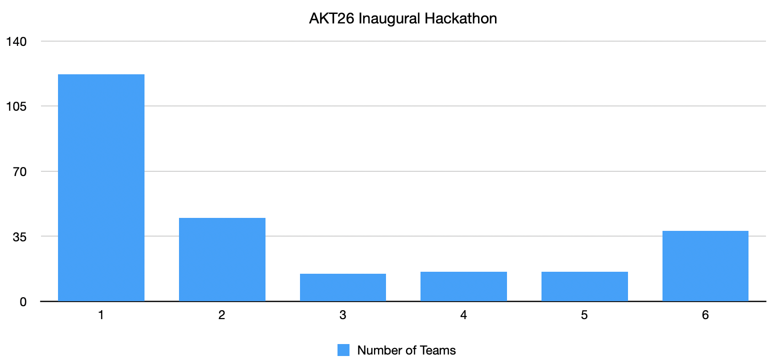
Statistics on Registration
600+ registered participants
80% students
Countries: Tunisia, Egypt, Morocco, USA, France, Saudi Arabia, UAE, India, Ireland, Azerbaijan, Spain, Pakistan, Bangladesh, Turkiye
Team number breakdown:

Slide 4
Team Formation
Participants may work individually or form a team.
Teams may have up to 6 members.
Participants are encouraged to form multidisciplinary teams combining different skills, such as programming, mathematics, AI, HPC, and scientific applications.
For student teams, we recommend — but do not require — that team members come from the same school, university, or institution.
Cross-institutional teams are welcome.
Participants who do not have a team may be matched with other participants where possible.

Slide 5
Guidelines
Participants are expected to:
Attend ALL the online sessions.
Actively contribute to their team.
Respect other participants and team members.
Share knowledge and collaborate constructively.
Follow the technical and submission requirements communicated before and during the hackathon.
Ensure that submitted work is their team’s own work and appropriately acknowledges any external software, datasets, or resources used.
Watch the recorded sessions for review important matters.

Slide 6
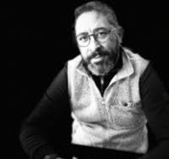
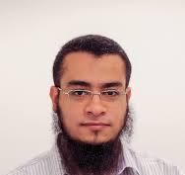
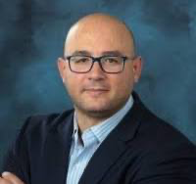
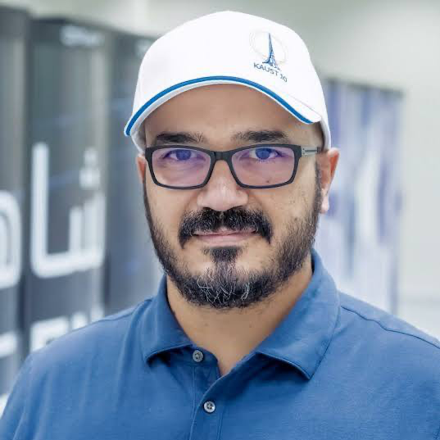
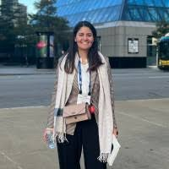
Presenters of the HaT Series
Rafik Borji
Ahmad Abdelfattah
Marouane Salhi
Hatem Ltaief
Nour Abou El-Nadar

Slide 7
Schedule
Session 1 and 2: ML/AI survival guides
  by Rafik Borji (TechnipFMC, USA)
Session 3 and 4: HPC/Linear Algebra/GPU Architecture and Programming
  by Hatem Ltaief (KAUST/AlgoDoers, KSA/France) and Ahmad Abdelfattah (UTK, USA)
Session 5: Quantum + AutoHPC
  by Marouan Salhi (Qubit Engineering, USA) and Nour Abou-Elnadar (Brightskies, Egypt)
Session 6: Demo Day for selected teams
  by ALL speakers and mentors

Slide 8
Scores and Ranking
Attendance Requirement: At least one member of each team must attend every webinar lecture. If no member of a team is present during a lecture, the team will be excluded from the HaT. They can always attend the remaining lectures but they will not be able to compete for the HaT.
Apply the following grading scheme:
  40% for ML/AI
  40% for HPC/LA/GPU
  20% for Presentation
Invite only selected teams for the demo day
Award the AKT26 Hackathon Prize for best teams
Select the best of the best teams to compete for the SCC @ ISC27 prestigious conference

Slide 9
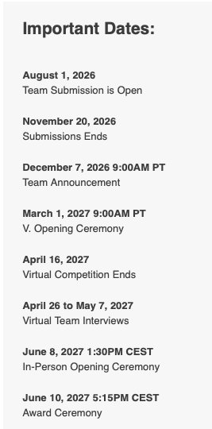

International Student Cluster Competition @ ISC27 Conference
https://isc-hpc.com/program/student-cluster-competition/

Slide 10
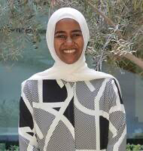
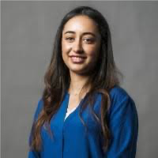
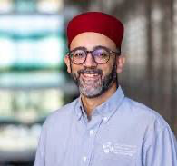
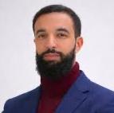



Mentors for SCC @ ISC27

Slide 11

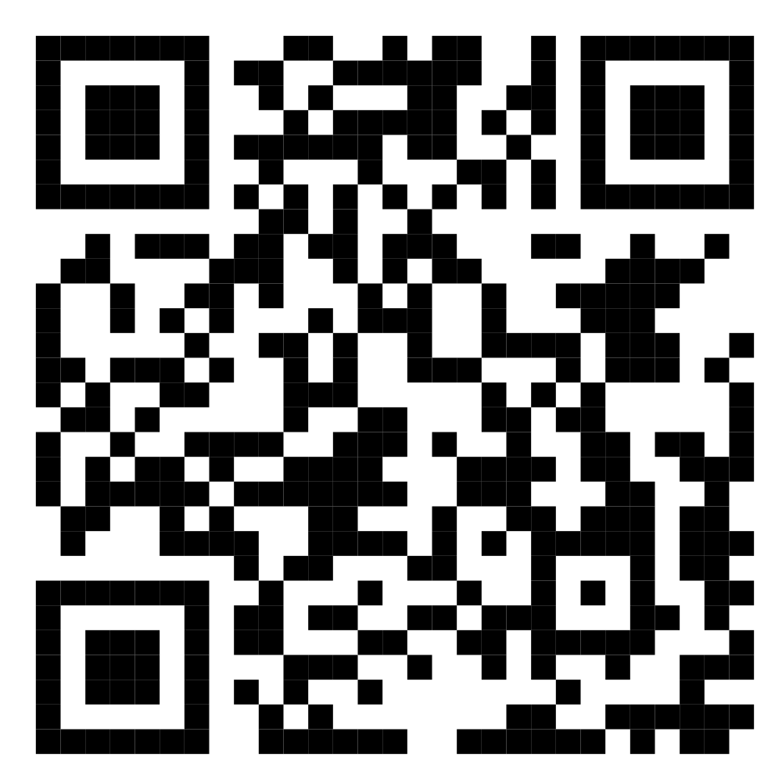
AKT26: Call For Posters

Slide 12








Contributors and Sponsors

